Slide 1
Introduction to Artificial Intelligence and Machine Learning
© Copyright IBM Corporation 2024

Slide 2

Machine Learning Algorithms
Notes:
Notes: Learning unit 1 AI Applications Strengths and Limitations

Slide 3

What is Machine Learning
Definition of ML:
Machine learning (ML), is an application of artificial intelligence (AI) that deals with teaching computers how to make decisions by learning from large amounts of data.
Major Types of ML
Supervised
Unsupervised
reinforcement
© Copyright IBM Corporation 2024
Notes:
Think of AI as giving machines "smarts" like humans. These machines can then do things like:
Understand what you say: Like Siri or Alexa, they can talk and even answer your questions.
Learn from experience: Imagine a self-driving car getting better at navigating with each drive.
Solve problems: AI can analyze data and suggest solutions, like doctors using AI to diagnose diseases.

Slide 4
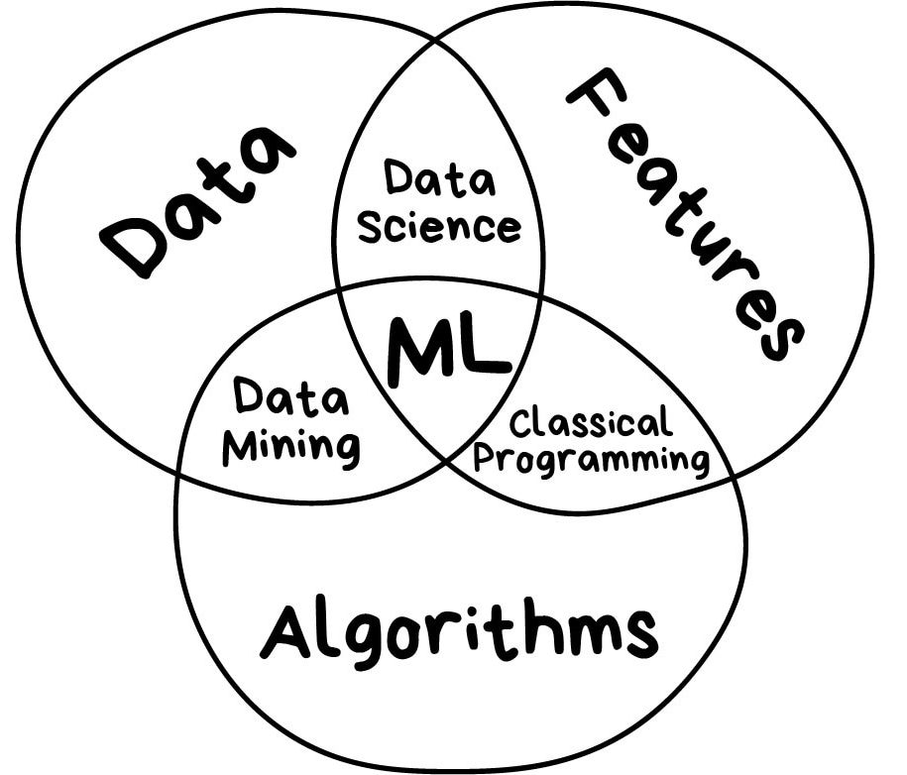
Three components of Machine Learning
Data : Want to detect spam? Get samples of spam messages. Want to forecast stocks? Find the price history. Want to find out user preferences? Parse their activities on Facebook
Features : Also known as parameters or variables. Those could be car mileage, user's gender, stock price, word frequency in the text. In other words, these are the factors for a machine to look at.
Algorithms: Most obvious part. Any problem can be solved differently. The method you choose affects the precision, performance, and size of the final model.
© Copyright IBM Corporation 2024
Notes:
Below are some key points highlighting the general importance of AI in the next industrial revolution:
Automation and Efficiency:
AI-powered automation goes beyond simple rule-based tasks. Machine learning algorithms enable systems to adapt and improve over time, handling complex and dynamic processes. This leads to increased efficiency as machines can learn from experience and continuously optimize their performance.
Data Analysis and Decision-Making:
The ability of AI to process and analyze massive datasets at high speeds is invaluable for decision-making. Businesses can extract meaningful insights, identify patterns, and make informed choices based on a comprehensive understanding of their operations and market conditions.
Predictive Maintenance:
Predictive maintenance uses AI algorithms to analyze historical data, sensor readings, and other relevant information to predict when equipment is likely to fail. This proactive approach reduces unplanned downtime, extends the lifespan of machinery, and ultimately saves businesses money by avoiding costly repairs.
Supply Chain Optimization:
AI enhances supply chain management through real-time data analysis, demand forecasting, and optimization of inventory levels. This leads to more efficient production schedules, reduced holding costs, and improved responsiveness to market changes and customer demands.
Personalization and Customization:
AI algorithms can analyze customer preferences, behaviors, and historical data to deliver highly personalized products and services. This level of customization not only enhances customer satisfaction but also creates opportunities for businesses to differentiate themselves in the market.
Human-Machine Collaboration:
Industry 4.0 promotes a collaborative environment where humans and AI systems work together synergistically. AI assists humans in tasks that require precision, speed, or data processing capabilities, while humans contribute their creativity, critical thinking, and emotional intelligence to problem-solving and decision-making processes.
Innovation and Product Development:
AI accelerates innovation by automating tedious tasks, such as data analysis and simulations, allowing researchers and developers to focus on creative and strategic aspects. This can lead to the faster development of new products, improved processes, and the exploration of novel solutions to complex challenges.
Cybersecurity:
AI is crucial in cybersecurity for threat detection and response. Machine learning algorithms can analyze network behavior, identify anomalies, and predict potential security threats. AI-driven cybersecurity systems enhance the overall resilience of organizations against evolving cyber threats.
Job Transformation:
While AI may automate some routine tasks, it also creates new roles and opportunities. The workforce of the future will need to acquire skills in areas such as data science, machine learning, and human-machine collaboration. Organizations and educational institutions play a vital role in providing training and support for these transitions.
Economic Growth and Competitiveness:
Countries and industries that invest in and effectively deploy AI technologies are likely to experience sustained economic growth. The increased efficiency, innovation, and competitiveness fostered by AI contribute to the overall development and global standing of economies.

Slide 5
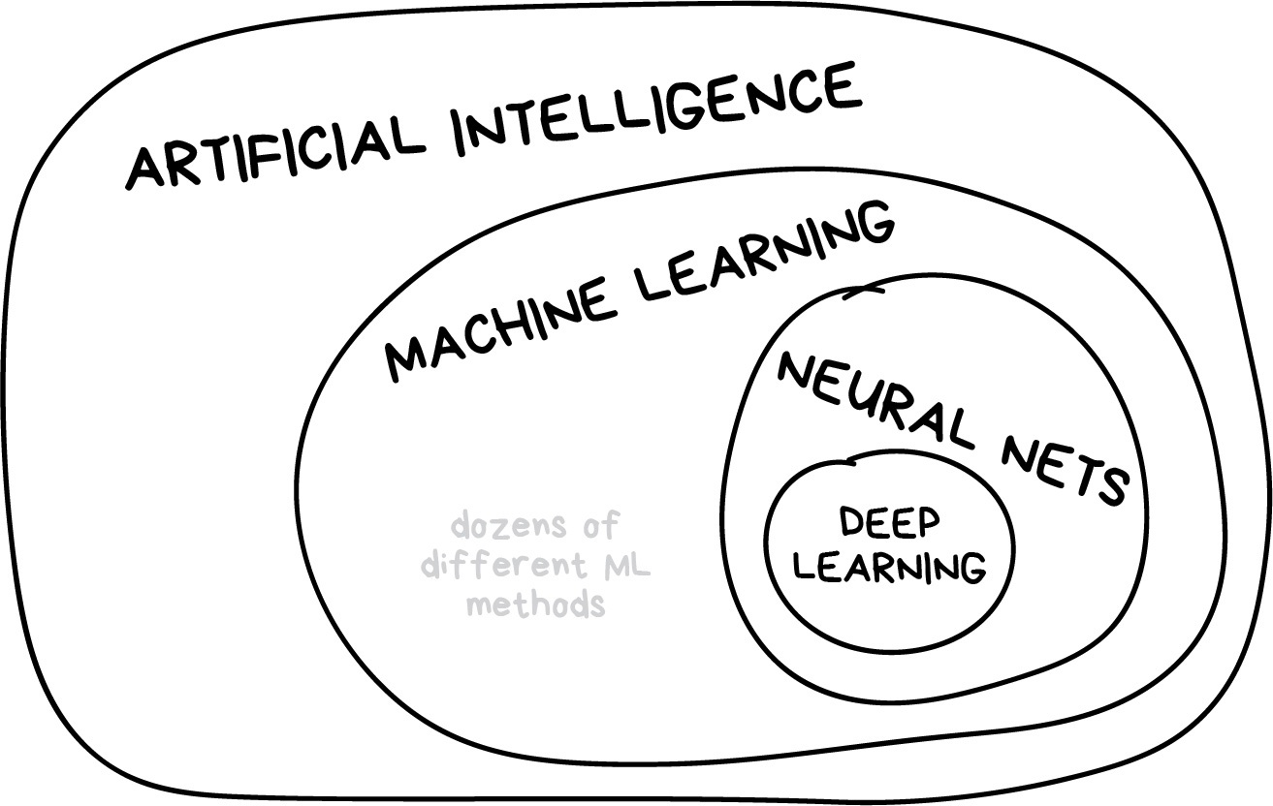
Learning vs Intelligence
Artificial intelligence is the name of a whole knowledge field, similar to biology or chemistry.
Machine Learning is a part of artificial intelligence. An important part, but not the only one.
Neural Networks are one of machine learning types.
Deep Learning is a modern method of building, training, and using neural networks. Basically, it's a new architecture
© Copyright IBM Corporation 2024
Notes:
Below are some key points highlighting the general importance of AI in the next industrial revolution:
Automation and Efficiency:
AI-powered automation goes beyond simple rule-based tasks. Machine learning algorithms enable systems to adapt and improve over time, handling complex and dynamic processes. This leads to increased efficiency as machines can learn from experience and continuously optimize their performance.
Data Analysis and Decision-Making:
The ability of AI to process and analyze massive datasets at high speeds is invaluable for decision-making. Businesses can extract meaningful insights, identify patterns, and make informed choices based on a comprehensive understanding of their operations and market conditions.
Predictive Maintenance:
Predictive maintenance uses AI algorithms to analyze historical data, sensor readings, and other relevant information to predict when equipment is likely to fail. This proactive approach reduces unplanned downtime, extends the lifespan of machinery, and ultimately saves businesses money by avoiding costly repairs.
Supply Chain Optimization:
AI enhances supply chain management through real-time data analysis, demand forecasting, and optimization of inventory levels. This leads to more efficient production schedules, reduced holding costs, and improved responsiveness to market changes and customer demands.
Personalization and Customization:
AI algorithms can analyze customer preferences, behaviors, and historical data to deliver highly personalized products and services. This level of customization not only enhances customer satisfaction but also creates opportunities for businesses to differentiate themselves in the market.
Human-Machine Collaboration:
Industry 4.0 promotes a collaborative environment where humans and AI systems work together synergistically. AI assists humans in tasks that require precision, speed, or data processing capabilities, while humans contribute their creativity, critical thinking, and emotional intelligence to problem-solving and decision-making processes.
Innovation and Product Development:
AI accelerates innovation by automating tedious tasks, such as data analysis and simulations, allowing researchers and developers to focus on creative and strategic aspects. This can lead to the faster development of new products, improved processes, and the exploration of novel solutions to complex challenges.
Cybersecurity:
AI is crucial in cybersecurity for threat detection and response. Machine learning algorithms can analyze network behavior, identify anomalies, and predict potential security threats. AI-driven cybersecurity systems enhance the overall resilience of organizations against evolving cyber threats.
Job Transformation:
While AI may automate some routine tasks, it also creates new roles and opportunities. The workforce of the future will need to acquire skills in areas such as data science, machine learning, and human-machine collaboration. Organizations and educational institutions play a vital role in providing training and support for these transitions.
Economic Growth and Competitiveness:
Countries and industries that invest in and effectively deploy AI technologies are likely to experience sustained economic growth. The increased efficiency, innovation, and competitiveness fostered by AI contribute to the overall development and global standing of economies.

Slide 6
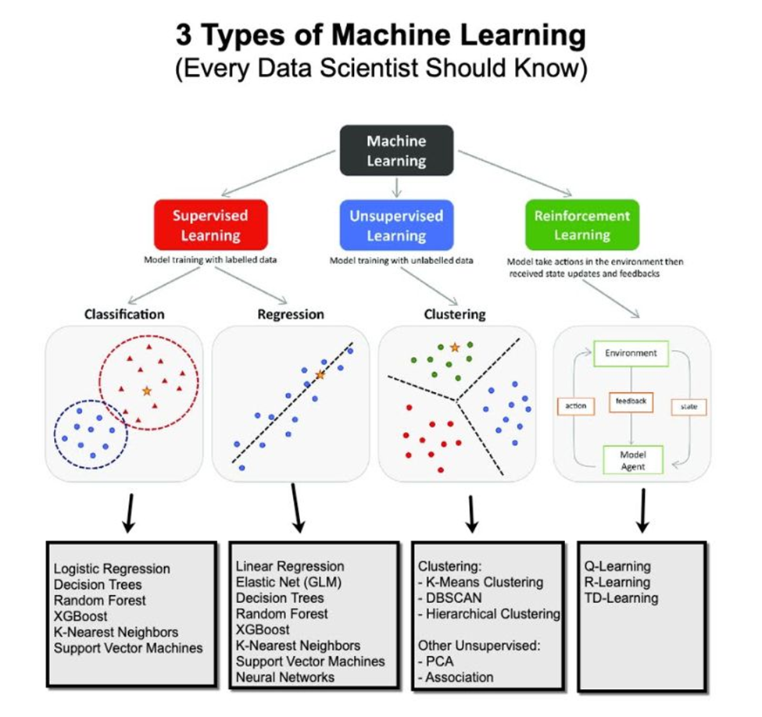
Machine Learning Types

Slide 7
Supervised Vs Unsupervised
Supervised Learning:
the machine has a "supervisor" or a "teacher" who gives the machine all the answers, like whether it's a apple in the picture or Mango.
The teacher has already divided (labeled) the data into apple pear and mango
the machine is using these examples to learn. One by one.
Unsupervised Learning:
Unsupervised learning means the machine is left on its own with a pile of animal photos and a task to find out who's who.
Data is not labeled, there's no teacher, the machine is trying to find any patterns on its own.

Slide 8
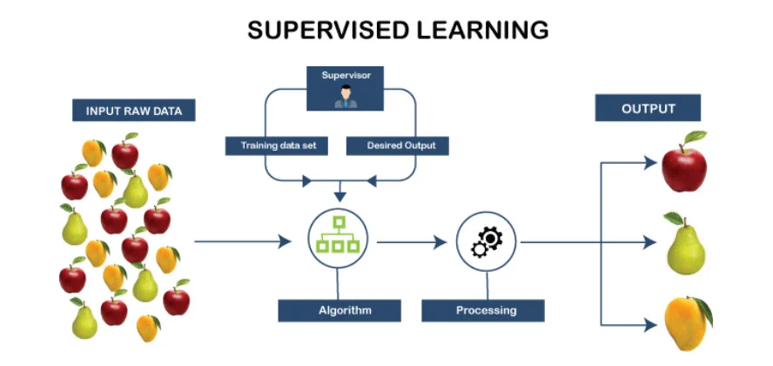

Slide 9
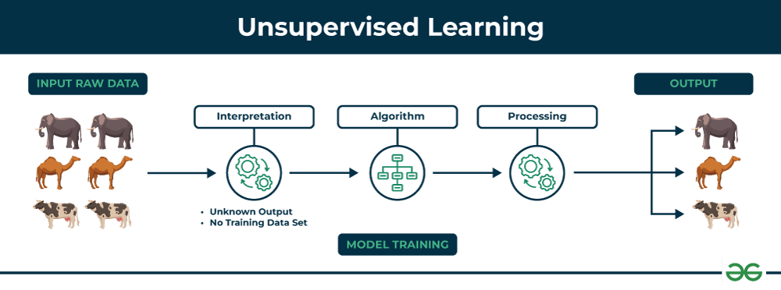

Slide 10
Supervised Algorithm
Major types
Regression
Classification

Slide 11
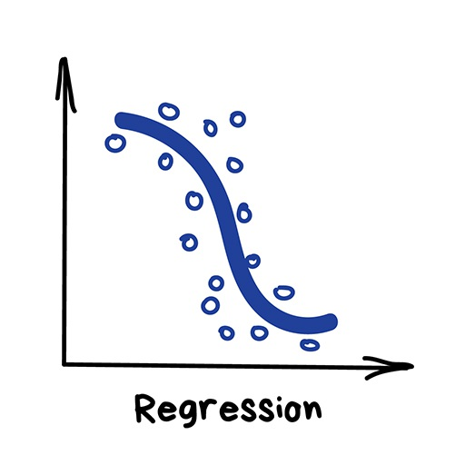
Regression
"Draw a line through these dots. Yep, that's the machine learning"
Today this is used for:
Stock price forecasts
Demand and sales volume analysis
Medical diagnosis
Any number-time correlations

Slide 12
Popular algorithm
Linear
Multi Linear
Polynomial

Slide 13
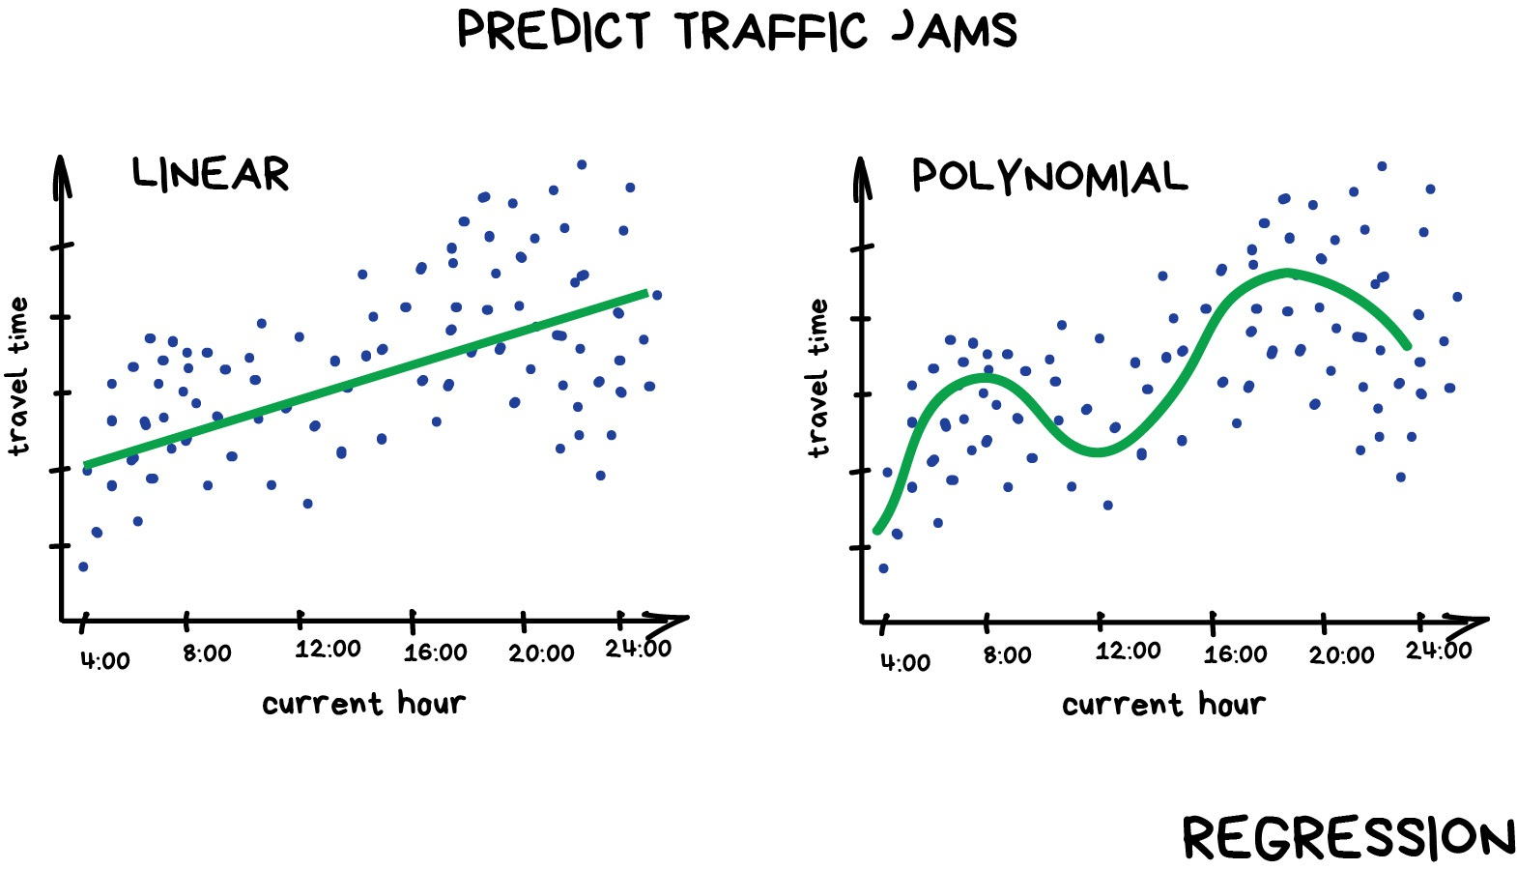

Slide 14
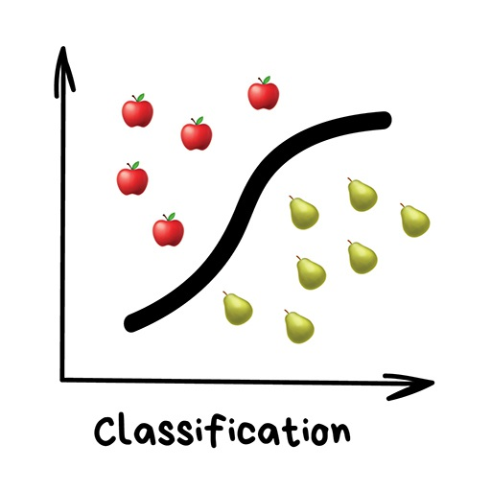
Classification
Splits objects based at one of the attributes known beforehand. Separate socks by based on color, documents based on language, music by genre“
Today used for: – Spam filtering – Language detection – A search of similar documents – Sentiment analysis – Recognition of handwritten characters and numbers – Fraud detection

Slide 15
Popular Classification Algorithms
Naive Bayes,
Decision Tree,
Logistic Regression,
K-Nearest Neighbours,
Support Vector Machine

Slide 16
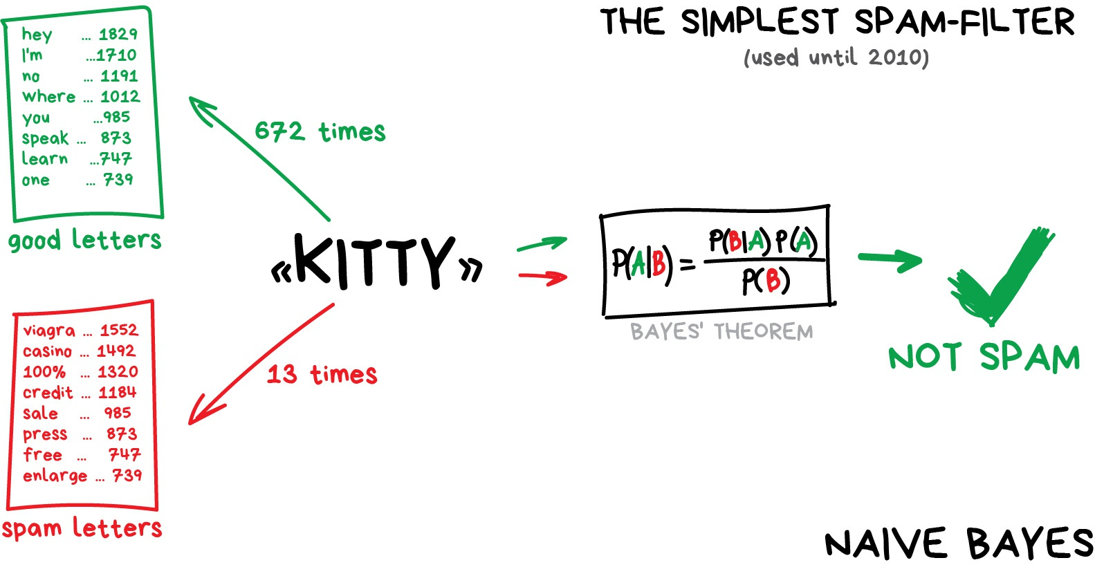
Naïve Bayes

Slide 17
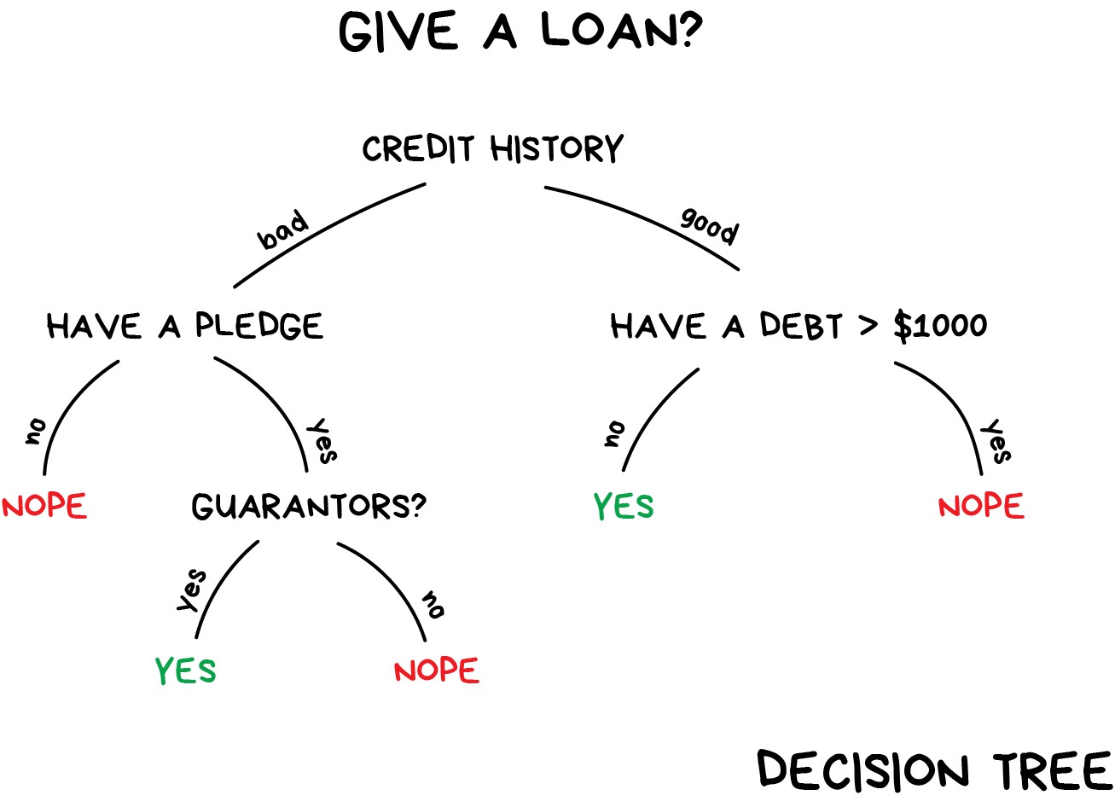
Decision Tree

Slide 18
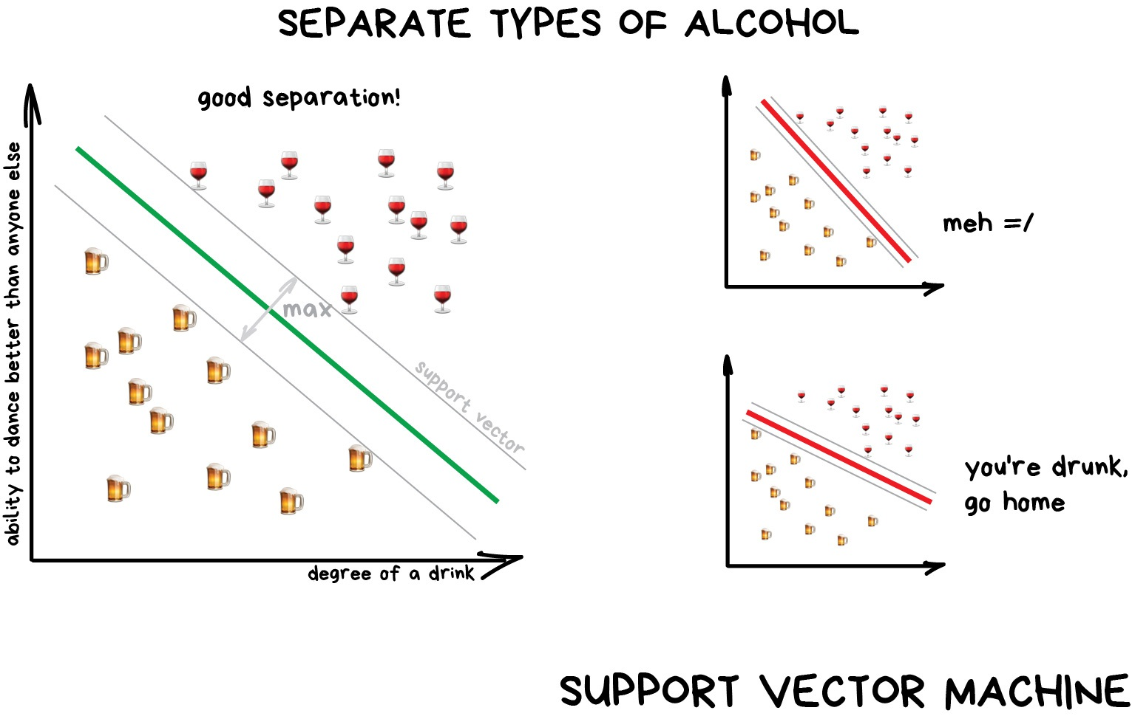
SVM

Slide 19
Unsupervised
Clustering
Dimensionality reduction

Slide 20
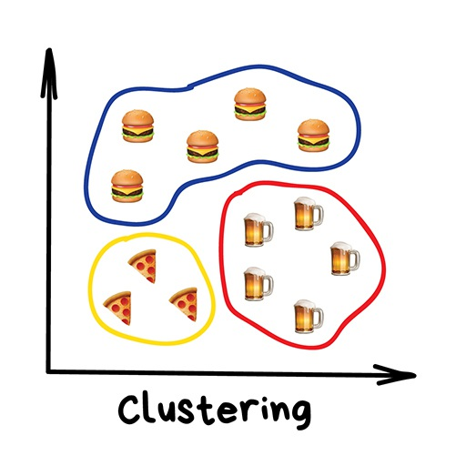
Clustering
"Divides objects based on unknown features. Machine chooses the best way"
Nowadays used:
For market segmentation (types of customers, loyalty)
To merge close points on a map
For image compression
To analyze and label new data
To detect abnormal behavior
Popular Algorithms
K-means_clustering
Mean-Shift
DBSCAN

Slide 21
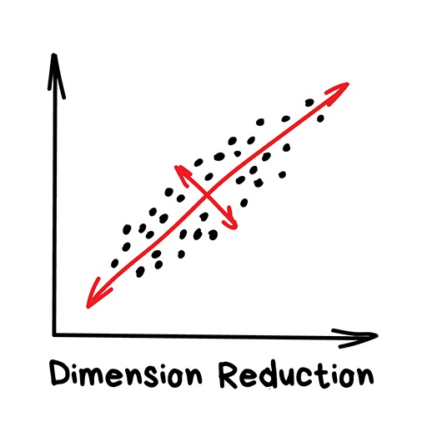
Dimensionality reduction
"Assembles specific features into more high-level ones"
Nowadays is used for:
Recommender systems (★)
Beautiful visualizations
Topic modeling and similar document search
Fake image analysis
Risk management
Popular algorithms:
Principal Component Analysis (PCA)
Singular Value Decomposition (SVD)

Slide 22
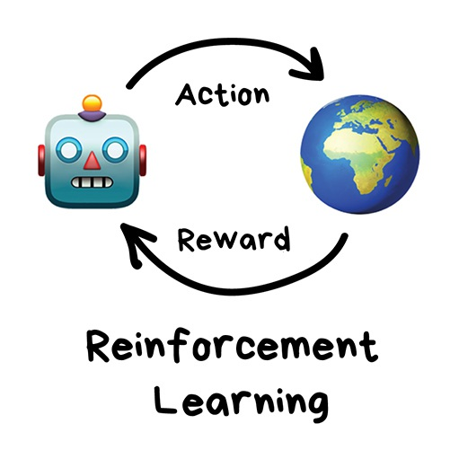
Reinforcement Algorithms
"Throw a robot into a maze and let it find an exit"
Nowadays used for:
Self-driving cars
Robot vacuums
Games
Automating trading
Enterprise resource management
Popular algorithms:
Q-Learning,
SARSA,
Genetic algorithm

Slide 23
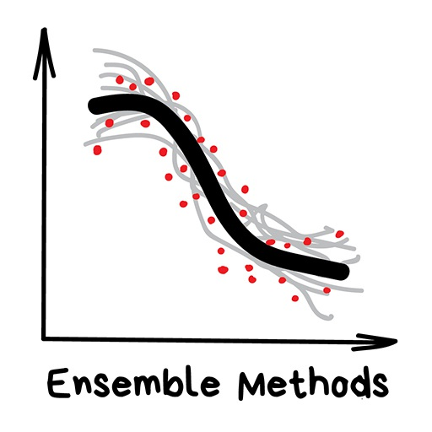
Ensemble Methods
"Bunch of stupid trees learning to correct errors of each other"
Nowadays is used for:
Everything that fits classical algorithm approaches (but works better)
Search systems (★)
Computer vision
Object detection
Popular algorithms:
Random Forest,
Gradient Boosting

Slide 24
Stacking
Stacking Output of several parallel models is passed as input to the last one which makes a final decision.

Slide 25
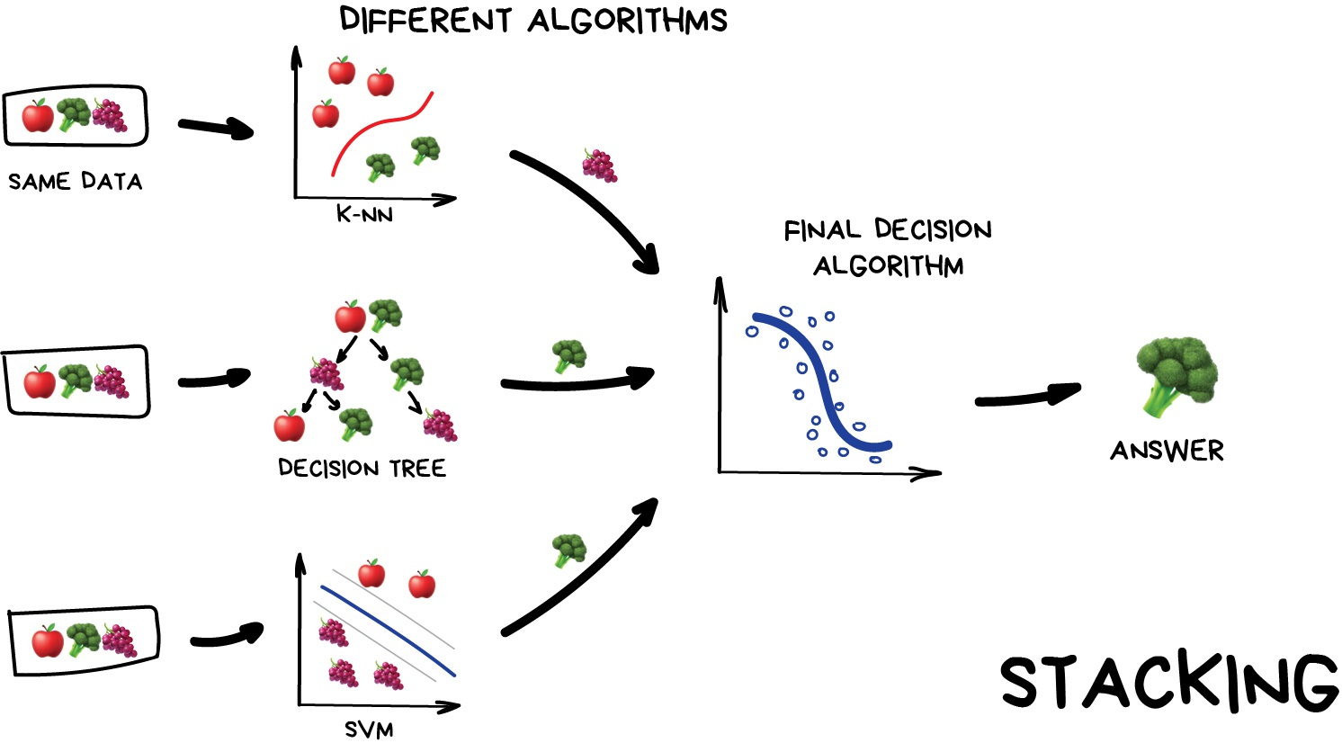

Slide 26
Bagging
Use the same algorithm but train it on different subsets of original data.
In the end — just average answers

Slide 27
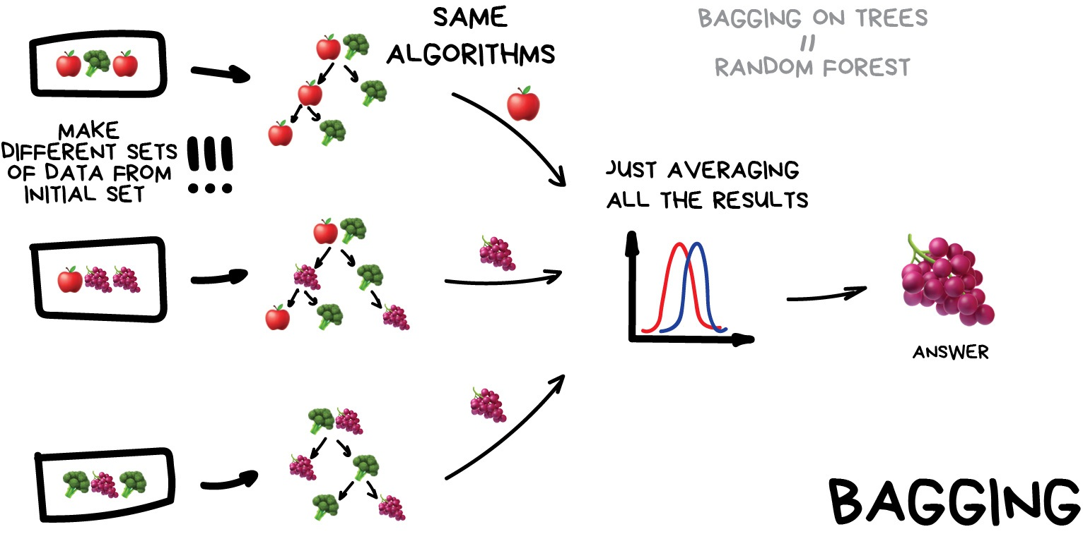

Slide 28
Boosting
Boosting Algorithms are trained one by one sequentially.
Each subsequent one paying most of its attention to data points that were mispredicted by the previous one.
Repeat until you are happy.
Same as in bagging, we use subsets of our data but this time they are not randomly generated.
Now, in each subsample we take a part of the data the previous algorithm failed to process.
Thus, we make a new algorithm learn to fix the errors of the previous one.

Slide 29
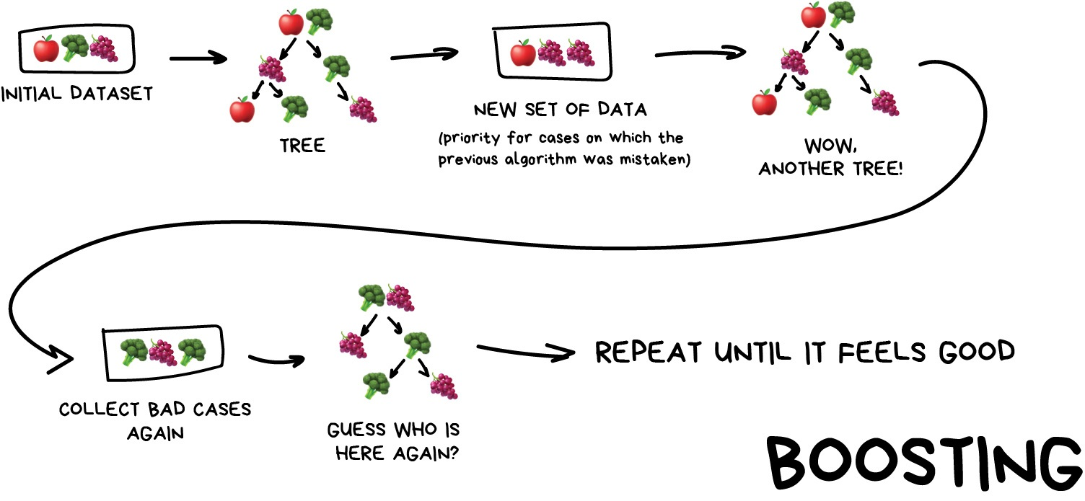

Slide 30
Branches of AI
Machine Learning
Machine Learning involves algorithms that learn from data. Use case includes recommendation systems, spam detection.
Deep Learning
Deep Learning is inspired by human brains and uses neural networks for complex tasks. Use case includes image recognition and language translation.
Natural Language Processing (NLP)
NLP enables computers to understand human language. Use case includes Chatbot, Virtual Assistant
© Copyright IBM Corporation 2024
Notes:
1. Machine Learning:
Think of it as teaching machines to learn by themselves. Just like you learn from experience, machine learning algorithms analyze data (like pictures, text, or numbers) to improve their skills. There are three main ways they do this:
Supervised Learning: Imagine a teacher showing you examples. The machine learns from labeled data, where each piece of information comes with a "correct answer." This helps it map inputs to outputs, like predicting what type of object is in a picture.
Unsupervised Learning: It's like figuring things out on your own. The machine gets unlabeled data and must find patterns or connections without any guidance. Think of organizing your messy room without instructions!
Reinforcement Learning: This is like learning through trial and error. The machine interacts with an environment, trying different things and getting rewarded for good choices. Think of a video game character learning to navigate by getting points for reaching the goal.
2. Deep Learning: This is a special type of machine learning inspired by the human brain. It uses complex networks of artificial "neurons" to understand and process information more deeply. This is powerful for things like recognizing faces in pictures or translating languages accurately.
3. Natural Language Processing (NLP): Can machines understand our language? NLP helps them do just that! It allows computers to read, understand, and even generate human language. This is used in chatbots, virtual assistants, and even machine translation tools.
4. Computer Vision: Just like our eyes see the world, computer vision helps machines "see" too. It enables them to analyze images and videos, recognizing objects, people, and even actions happening within them. Think of self-driving cars using this to avoid obstacles!
Note that these are just a few branches of the vast AI tree. There are many other exciting areas like robotics, expert systems, and knowledge representation waiting to be explored!
5. Robotic. Robots in industrial settings can use Narrow AI to perform routine, repetitive tasks that involve materials handling, assembly and quality inspections.
In healthcare, robots equipped with Narrow AI can assist surgeons in monitoring vitals and detecting potential issues during procedures.
Agricultural machines can engage in autonomous pruning, moving, thinning, seeding and spraying.
Smart home devices such as the iRobot Roomba can navigate a home’s interior using computer vision and use data stored in memory to understand its progress.
6. Expert systems equipped with Narrow AI capabilities can be trained on a corpus to emulate the human decision-making process and apply expertise to solve complex problems. These systems can evaluate vast amounts of data to uncover trends and patterns to make decisions. They can also help businesses predict future events and understand why past events occurred.

Slide 31
Branches of AI
Computer Vision
Computer Vision allows machines to interpret visual information to analyse images and videos. Use case includes object detection.
Expert Systems
Expert systems equipped with Narrow AI capabilities can be trained on a corpus to emulate the human decision-making process and apply expertise to solve complex problems. These systems can evaluate vast amounts of data to uncover trends and patterns to make decisions. They can also help businesses predict future events and understand why past events occurred.
© Copyright IBM Corporation 2024
Notes:
1. Machine Learning:
Think of it as teaching machines to learn by themselves. Just like you learn from experience, machine learning algorithms analyze data (like pictures, text, or numbers) to improve their skills. There are three main ways they do this:
Supervised Learning: Imagine a teacher showing you examples. The machine learns from labeled data, where each piece of information comes with a "correct answer." This helps it map inputs to outputs, like predicting what type of object is in a picture.
Unsupervised Learning: It's like figuring things out on your own. The machine gets unlabeled data and must find patterns or connections without any guidance. Think of organizing your messy room without instructions!
Reinforcement Learning: This is like learning through trial and error. The machine interacts with an environment, trying different things and getting rewarded for good choices. Think of a video game character learning to navigate by getting points for reaching the goal.
2. Deep Learning: This is a special type of machine learning inspired by the human brain. It uses complex networks of artificial "neurons" to understand and process information more deeply. This is powerful for things like recognizing faces in pictures or translating languages accurately.
3. Natural Language Processing (NLP): Can machines understand our language? NLP helps them do just that! It allows computers to read, understand, and even generate human language. This is used in chatbots, virtual assistants, and even machine translation tools.
4. Computer Vision: Just like our eyes see the world, computer vision helps machines "see" too. It enables them to analyze images and videos, recognizing objects, people, and even actions happening within them. Think of self-driving cars using this to avoid obstacles!
Note that these are just a few branches of the vast AI tree. There are many other exciting areas like robotics, expert systems, and knowledge representation waiting to be explored!
5. Robotic. Robots in industrial settings can use Narrow AI to perform routine, repetitive tasks that involve materials handling, assembly and quality inspections.
In healthcare, robots equipped with Narrow AI can assist surgeons in monitoring vitals and detecting potential issues during procedures.
Agricultural machines can engage in autonomous pruning, moving, thinning, seeding and spraying.
Smart home devices such as the iRobot Roomba can navigate a home’s interior using computer vision and use data stored in memory to understand its progress.
6. Expert systems equipped with Narrow AI capabilities can be trained on a corpus to emulate the human decision-making process and apply expertise to solve complex problems. These systems can evaluate vast amounts of data to uncover trends and patterns to make decisions. They can also help businesses predict future events and understand why past events occurred.

Slide 32
Branches of AI
Robotic
Robots in industrial settings can use Narrow AI to perform routine, repetitive tasks that involve materials handling, assembly and quality inspections.
In healthcare, robots equipped with Narrow AI can assist surgeons in monitoring vitals and detecting potential issues during procedures.
Agricultural machines can engage in autonomous pruning, moving, thinning, seeding and spraying.
Smart home devices such as the iRobot Roomba can navigate a home’s interior using computer vision and use data stored in memory to understand its progress.
© Copyright IBM Corporation 2024
Notes:
1. Machine Learning:
Think of it as teaching machines to learn by themselves. Just like you learn from experience, machine learning algorithms analyze data (like pictures, text, or numbers) to improve their skills. There are three main ways they do this:
Supervised Learning: Imagine a teacher showing you examples. The machine learns from labeled data, where each piece of information comes with a "correct answer." This helps it map inputs to outputs, like predicting what type of object is in a picture.
Unsupervised Learning: It's like figuring things out on your own. The machine gets unlabeled data and must find patterns or connections without any guidance. Think of organizing your messy room without instructions!
Reinforcement Learning: This is like learning through trial and error. The machine interacts with an environment, trying different things and getting rewarded for good choices. Think of a video game character learning to navigate by getting points for reaching the goal.
2. Deep Learning: This is a special type of machine learning inspired by the human brain. It uses complex networks of artificial "neurons" to understand and process information more deeply. This is powerful for things like recognizing faces in pictures or translating languages accurately.
3. Natural Language Processing (NLP): Can machines understand our language? NLP helps them do just that! It allows computers to read, understand, and even generate human language. This is used in chatbots, virtual assistants, and even machine translation tools.
4. Computer Vision: Just like our eyes see the world, computer vision helps machines "see" too. It enables them to analyze images and videos, recognizing objects, people, and even actions happening within them. Think of self-driving cars using this to avoid obstacles!
Note that these are just a few branches of the vast AI tree. There are many other exciting areas like robotics, expert systems, and knowledge representation waiting to be explored!
5. Robotic. Robots in industrial settings can use Narrow AI to perform routine, repetitive tasks that involve materials handling, assembly and quality inspections.
In healthcare, robots equipped with Narrow AI can assist surgeons in monitoring vitals and detecting potential issues during procedures.
Agricultural machines can engage in autonomous pruning, moving, thinning, seeding and spraying.
Smart home devices such as the iRobot Roomba can navigate a home’s interior using computer vision and use data stored in memory to understand its progress.
6. Expert systems equipped with Narrow AI capabilities can be trained on a corpus to emulate the human decision-making process and apply expertise to solve complex problems. These systems can evaluate vast amounts of data to uncover trends and patterns to make decisions. They can also help businesses predict future events and understand why past events occurred.

Slide 33
Different Branches of AI (Cont)
Emulate human decision-making process
Self Driving Cars
Expert Systems
iRobot Roomba
Computer Vision
Robotic
Branches
of AI
Predict Object in Picture
Natural Language
Processing (NLP)
Chatbots, Virtual
Assistants
Supervised Learning
Labeled Data
Machine Learning
Neural Network /
Deep Learning
Reinforcement Learning
Trial and Error
Unsupervised Learning
Unlabeled Data
Face Recognition,
Language Translation
Organize Messy Room
Video Games
© Copyright IBM Corporation 2024
Notes:
1. Machine Learning:
Think of it as teaching machines to learn by themselves. Just like you learn from experience, machine learning algorithms analyze data (like pictures, text, or numbers) to improve their skills. There are three main ways they do this:
Supervised Learning: Imagine a teacher showing you examples. The machine learns from labeled data, where each piece of information comes with a "correct answer." This helps it map inputs to outputs, like predicting what type of object is in a picture.
Unsupervised Learning: It's like figuring things out on your own. The machine gets unlabeled data and must find patterns or connections without any guidance. Think of organizing your messy room without instructions!
Reinforcement Learning: This is like learning through trial and error. The machine interacts with an environment, trying different things and getting rewarded for good choices. Think of a video game character learning to navigate by getting points for reaching the goal.
2. Deep Learning: This is a special type of machine learning inspired by the human brain. It uses complex networks of artificial "neurons" to understand and process information more deeply. This is powerful for things like recognizing faces in pictures or translating languages accurately.
3. Natural Language Processing (NLP): Can machines understand our language? NLP helps them do just that! It allows computers to read, understand, and even generate human language. This is used in chatbots, virtual assistants, and even machine translation tools.
4. Computer Vision: Just like our eyes see the world, computer vision helps machines "see" too. It enables them to analyze images and videos, recognizing objects, people, and even actions happening within them. Think of self-driving cars using this to avoid obstacles!
Note that these are just a few branches of the vast AI tree. There are many other exciting areas like robotics, expert systems, and knowledge representation waiting to be explored!

Slide 34
Historical and Evolution of AI
Key milestones in AI history (e.g., Dartmouth Conference, emergence of expert systems):
AI has a rich history marked by significant events such as the Dartmouth Conference in 1956 and the development of expert systems in the 1960s.
Evolution of AI approaches over time:
AI approaches have evolved from early symbolic systems to more recent advancements in machine learning and deep learning.
Major breakthroughs and developments in AI research:
Breakthroughs such as the development of neural networks and deep learning have propelled AI forward and opened up new possibilities for applications.
© Copyright IBM Corporation 2024

Slide 35
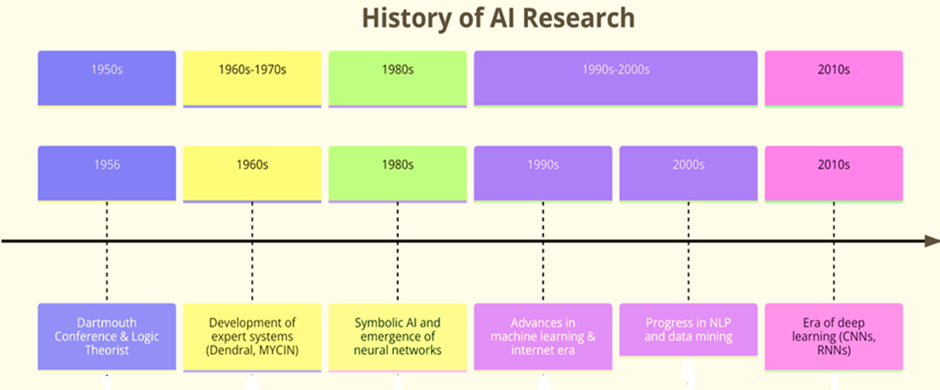
Key Developments of AI
2020s
2020s
Large Language
Models –
Generative Models
© Copyright IBM Corporation 2024
Notes:
1. Early AI (1950s - 1970s)
Symbolic AI Era: Focus on rule-based systems and logic to mimic human reasoning. Early AI research aimed at understanding and replicating human intelligence.
Key Concepts: Expert systems, logic programming
2. The Rise of Machine Learning (1980s - 1990s)
Shift to Learning from Data: Introduction of algorithms that could learn from data, marking a shift from hard-coded knowledge.
Key Concepts: Decision trees, neural networks, support vector machines.
Notable Development: Backpropagation algorithm revitalizes neural network research.
3. The Era of Big Data and Advanced Algorithms (2000s - Early 2010s)
Massive Increase in Data Availability: The internet and digitalization lead to an explosion of data.
Advancements in Computational Power: GPUs begin to be used for training, significantly speeding up the process.
Key Concepts: Deep learning, convolutional neural networks (CNNs), recurrent neural networks (RNNs).
Breakthroughs: Success in image recognition (ImageNet challenge), speech recognition, and other domains.
4. The Rise of Deep Learning and Foundation Models (Mid-2010s - Present)
Deep Learning Dominance: Deep neural networks become the go-to method for a wide range of AI tasks.
Foundation Models Emerge: Models that are pre-trained on vast datasets and can be fine-tuned for specific tasks.
Key Concepts: Transformer architecture, attention mechanisms.
Large Language Models (LLMs): A subset of foundation models specialized in understanding and generating human language.
Notable Models: GPT (Generative Pre-trained Transformer), BERT (Bidirectional Encoder Representations from Transformers), T5 (Text-to-Text Transfer Transformer), etc.
Applications: Natural language processing (NLP), machine translation, content generation, question answering, and more.

Slide 36
Current State of AI
Recent advancements in AI
Challenges facing AI
Implications of AI for society
AI has made significant progress in areas such as natural language processing and pattern recognition, leading to applications like chatbots and image recognition.
Despite its progress, AI faces challenges such as ethical concerns regarding bias and fairness, as well as the need to ensure the robustness and reliability of AI systems.
AI has profound implications for society, including changes in employment patterns and privacy concerns, which must be addressed responsibly.
© Copyright IBM Corporation 2024
Notes:
As of the present day, Artificial Intelligence (AI) stands at the forefront of technological innovation, having achieved remarkable advancements and widespread adoption across various domains. This section provides a detailed examination of the current state of AI, focusing on its advancements, challenges, and implications for society

Slide 37
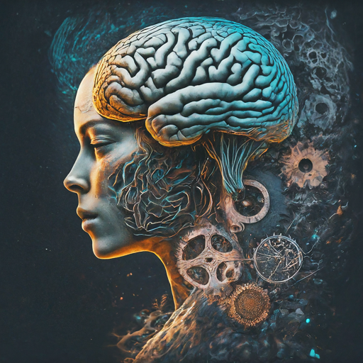
Advancements in AI
AI has achieved remarkable progress, venturing into areas once exclusive to human intelligence.
Natural Language Understanding (NLU)
Machines grasp human language (written & spoken)
Translation, chatbots, sentiment analysis
Pattern Recognition
AI excels at identifying complex patterns
Image/speech recognition, medical diagnosis, finance
Deep learning particularly effective
© Copyright IBM Corporation 2024
Notes:
AI systems have attained unprecedented levels of sophistication, demonstrating capabilities that were once considered exclusive to human intelligence. Some key advancements include:
Natural Language Understanding: AI-powered systems have made significant strides in understanding and processing human language. Natural Language Processing (NLP) techniques enable machines to comprehend written and spoken language, facilitate translation between languages, and extract insights from textual data.
Pattern Recognition: AI algorithms excel at recognizing complex patterns and structures within vast datasets. From image and speech recognition to medical diagnosis and financial forecasting, AI systems leverage advanced techniques such as deep learning to extract meaningful information and make accurate predictions.
Autonomous Decision-making: AI-driven decision-making processes have become increasingly autonomous and adaptive. Reinforcement learning algorithms enable machines to learn optimal strategies through trial and error, leading to advancements in areas such as robotics, self-driving cars, and game playing.
Breakthroughs in AI Research: Recent breakthroughs in AI research have expanded the frontiers of the field. Techniques such as generative models, which can create new data samples, and transfer learning, which enables knowledge transfer between different tasks or domains, have opened new possibilities for AI applications.

Slide 38
Advancements in AI (cont.)
Autonomous Decision-Making
AI makes decisions with increasing autonomy
Reinforcement learning for optimal strategies
Robotics, self-driving cars, game playing
Breakthroughs in AI Research
Generative models create new data (images, text)
Transfer learning transfers knowledge across tasks
© Copyright IBM Corporation 2024
Notes:
AI systems have attained unprecedented levels of sophistication, demonstrating capabilities that were once considered exclusive to human intelligence. Some key advancements include:
Natural Language Understanding: AI-powered systems have made significant strides in understanding and processing human language. Natural Language Processing (NLP) techniques enable machines to comprehend written and spoken language, facilitate translation between languages, and extract insights from textual data.
Pattern Recognition: AI algorithms excel at recognizing complex patterns and structures within vast datasets. From image and speech recognition to medical diagnosis and financial forecasting, AI systems leverage advanced techniques such as deep learning to extract meaningful information and make accurate predictions.
Autonomous Decision-making: AI-driven decision-making processes have become increasingly autonomous and adaptive. Reinforcement learning algorithms enable machines to learn optimal strategies through trial and error, leading to advancements in areas such as robotics, self-driving cars, and game playing.
Breakthroughs in AI Research: Recent breakthroughs in AI research have expanded the frontiers of the field. Techniques such as generative models, which can create new data samples, and transfer learning, which enables knowledge transfer between different tasks or domains, have opened new possibilities for AI applications.

Slide 39
Subtopic AI Terminology and Concepts
© Copyright IBM Corporation 2024
Notes:
Notes: Learning Unit: 1 AI Applications Strengths and Limitations, Subtopic AI Terminology and Concepts

Slide 40
AI Terminology
Algorithm:
Algorithms are procedures, often described in mathematical language or pseudocode, to be applied to a dataset to achieve a certain function or purpose. It's the backbone of AI systems, guiding how they process information, make predictions, and learn from data..
Model:
Models are the output of an algorithm that has been applied to a dataset..
Labeled datasets
A labeled dataset includes data, like images or text, with attached labels indicating their category or attribute. These labels, provided by humans, are vital for supervised machine learning tasks.
© Copyright IBM Corporation 2024

Slide 41
AI Terminology
Features:
Features refer to the individual measurable properties or characteristics of data points, such as pixels in an image, words in a text document, or numerical attributes in a dataset. These features are used as input variables for machine learning algorithms to learn patterns and make predictions.
Overfitting
Overfitting occurs when an ML model fits training data too closely, causing irrelevant information (or “noise”) in the sample dataset to influence the model’s performance.
Underfitting
Underfitting is its opposite: improper or inadequate training.
© Copyright IBM Corporation 2024

Slide 42
Machine Learning Algorithms
Definition:
Machine learning algorithms enable computers to learn from data and make predictions or decisions without explicit programming.
Types:
Supervised learning, unsupervised learning, reinforcement learning.
© Copyright IBM Corporation 2024

Slide 43
Supervised Learning
Definition:
Supervised learning involves training algorithms on labeled datasets with input features and corresponding target labels.
Strengths:
Structured data handling, complex pattern recognition, high accuracy.
Limitations:
Data labeling requirement, generalization to unseen data, risk of overfitting.
Examples:
Predicting housing prices based on features such as square footage, number of bedrooms, and location. The algorithm learns from a dataset containing labeled examples of housing attributes and their corresponding sale prices.
© Copyright IBM Corporation 2024
Notes:
1. Supervised Learning:
Supervised learning is a type of machine learning where the algorithm is trained on a labeled dataset. Each example in the dataset consists of input features and corresponding target labels. The algorithm learns to map inputs to outputs by observing the relationships between features and labels in the training data. This learned mapping allows the algorithm to make predictions or decisions when presented with new, unseen data.
Example: Consider a supervised learning task of predicting housing prices based on features such as square footage, number of bedrooms, and location. In this scenario, the algorithm learns from a dataset containing labeled examples of housing attributes and their corresponding sale prices.
Strengths:
Structured Data Handling: Supervised learning is well-suited for tasks with clear and structured data, where the relationship between inputs and outputs can be explicitly defined.
Complex Pattern Recognition: The algorithm can learn complex patterns and relationships between input features and target labels, enabling it to make accurate predictions.
High Accuracy: With sufficient and high-quality labeled data, supervised learning models can achieve high accuracy in prediction tasks.
Challenges:
Data Labeling Requirement: Supervised learning requires labeled data for training, which can be expensive and time-consuming to obtain, especially for large datasets.
Generalization to Unseen Data: The model may struggle to generalize to unseen data or handle outliers that deviate significantly from the training examples.
Overfitting: There is a risk of overfitting if the model is too complex relative to the amount of training data, leading to inferior performance on new data.

Slide 44
Unsupervised Learning
Definition:
Unsupervised learning trains algorithms on unlabeled data to discover hidden patterns or structures.
Strengths:
Pattern discovery, exploratory data analysis, scalability.
Limitations:
Evaluation challenges, interpretability, sensitivity to data characteristics.
Examples:
An unsupervised learning task could involve clustering similar customer segments based on their purchasing behavior without prior knowledge of specific customer groups.
© Copyright IBM Corporation 2024
Notes:
2. Unsupervised Learning:
Unsupervised learning involves training the algorithm on unlabeled data, where there are no predefined target variables. The algorithm's objective is to discover hidden patterns or structures within the data without explicit guidance. Instead, the algorithm identifies similarities, differences, or relationships among data points to uncover meaningful insights.
Example: An unsupervised learning task could involve clustering similar customer segments based on their purchasing behavior without prior knowledge of specific customer groups.
Strengths:
Pattern Discovery: Unsupervised learning can uncover hidden insights and patterns in data that may not be apparent through manual inspection.
Exploratory Data Analysis: It is useful for exploratory data analysis and feature discovery, enabling analysts to gain a deeper understanding of the underlying structure of the data.
Scalability: Unsupervised learning doesn't require labeled data, making it more scalable and applicable to a wide range of domains.
Challenges:
Evaluation Challenges: Since there are no ground truth labels in unsupervised learning, evaluating the performance of the model can be challenging, and the results may be subjective.
Interpretability: The learned representations or clusters may be difficult to interpret, making it challenging to derive actionable insights from the model.
Sensitivity to Data Characteristics: Performance may degrade with high-dimensional or noisy data, and the algorithm's effectiveness can vary depending on the data distribution.

Slide 45
Reinforcement Learning
Definition:
Reinforcement learning involves agents learning optimal behavior through interaction with environments and feedback in the form of rewards or penalties.
Strengths:
Sequential decision making, complex strategy learning, versatility..
Limitations:
Computational complexity, reward design challenges, instability.
Examples:
Training an AI agent to navigate a maze by rewarding it for reaching the goal and penalizing it for colliding with obstacles..
© Copyright IBM Corporation 2024
Notes:
3. Reinforcement Learning:
Reinforcement learning is a type of machine learning where an agent learns to interact with an environment to achieve a predefined goal. The agent receives feedback in the form of rewards or penalties based on its actions, guiding it towards learning optimal behavior through trial and error.
Example: Training an AI agent to navigate a maze by rewarding it for reaching the goal and penalizing it for colliding with obstacles.
Strengths:
Sequential Decision Making: Reinforcement learning is well-suited for tasks involving sequential decision making and long-term planning, where actions affect future states and outcomes.
Complex Strategy Learning: The agent can learn complex strategies and adapt to changing environments, allowing it to handle dynamic and uncertain scenarios effectively.
Versatility: Reinforcement learning is applicable to a wide range of domains, including robotics, gaming, finance, and autonomous systems.
Challenges:
Computational Complexity: Training reinforcement learning agents can be computationally expensive and time-consuming, especially for tasks with large state and action spaces.
Reward Design Challenges: Designing effective reward structures and exploration strategies is crucial for successful reinforcement learning, and poorly designed rewards can lead to suboptimal behavior.
Instability and Convergence Issues: Reinforcement learning algorithms may suffer from instability and convergence issues, particularly in high-dimensional or continuous action spaces, requiring careful tuning and optimization.

Slide 46
Model Training and Evaluation
Model Training Process:
Involves iteratively adjusting model parameters to minimize prediction errors and assessing model performance on unseen data. Objective is to develop effective and accurate predictive models.
Evaluation Metrics:
Evaluation metrics are used to assess the effectiveness of trained AI models
Addressing Overfitting and Underfitting:
Overfitting occurs when a model captures noise or irrelevant patterns from the training data
Underfitting occurs when a model is too simplistic to capture the underlying structure of the
© Copyright IBM Corporation 2024
Notes:
Overfitting occurs when a model captures noise or irrelevant patterns from the training data, resulting in excessively complex representations that fail to generalize well to unseen data. This phenomenon can lead to poor performance on real-world datasets, as the model memorizes the training examples rather than learning the underlying patterns
Underfitting occurs when a model is too simplistic to capture the underlying structure of the data, resulting in suboptimal predictive performance. The model fails to capture the complexities and nuances present in the dataset, leading to poor generalization.

Slide 47
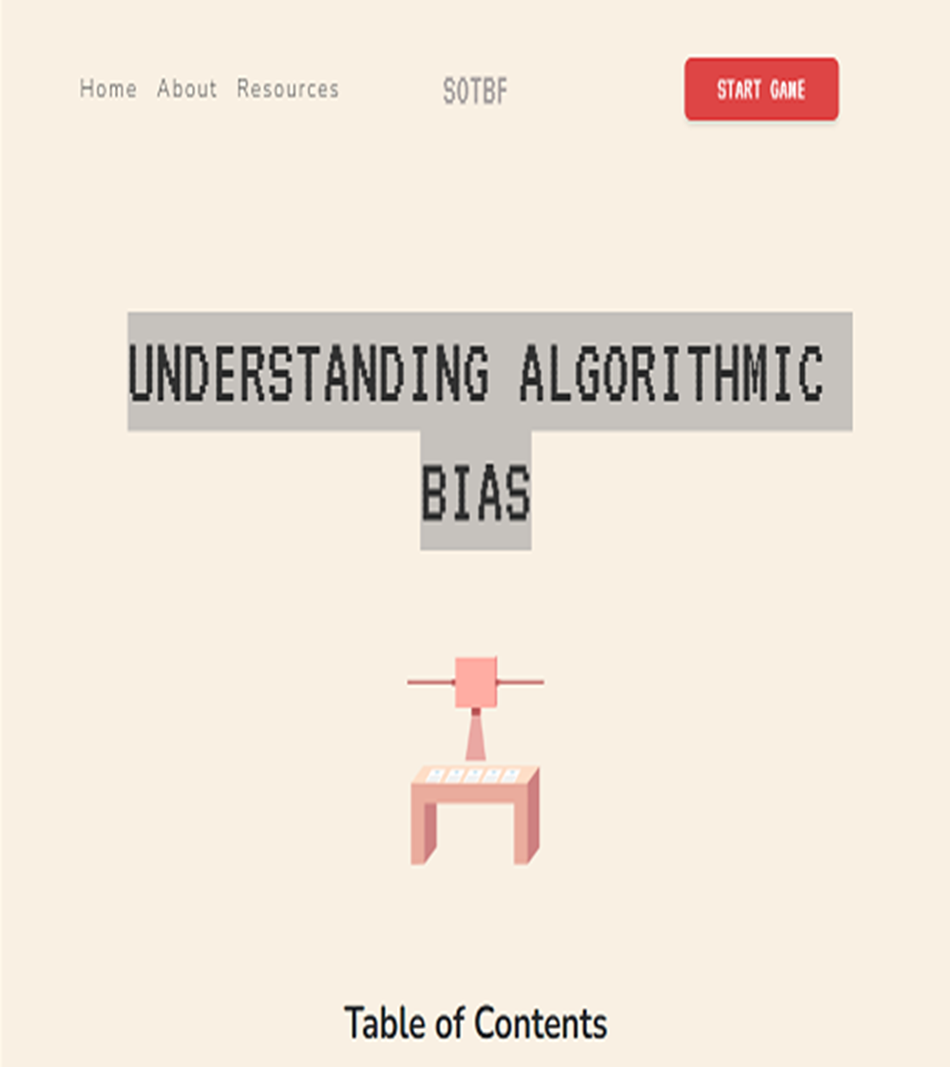
Play a Game
•Please navigate to the Understanding Algorithmic Bias https://www.survivalofthebestfit.com/resources
•Click “Start Game” and have a look at the end result.
•What do you think ?

Slide 48
Subtopic AI Applications
© Copyright IBM Corporation 2024
Notes:
Notes: Learning Unit: 1 AI Applications Strengths and Limitations, Subtopic AI Terminology and Concepts

Slide 49
AI Applications in Retail
AI's transformative Role in Retail
Personalizing customer experiences, optimizing operations, and enhancing competitiveness.
Retail industry undergoing significant transformation driven by AI's analytical capabilities.
AI analyses data to inform decisions, improving aspects such as pricing, inventory management, and customer engagement.
Enhanced shopping experience through AI-driven personalization and targeted recommendations.
Improved efficiency and profitability for retailers by leveraging AI for data-driven decision-making and automation.
© Copyright IBM Corporation 2024
Notes:
The retail industry is undergoing a significant transformation, driven by the power of artificial intelligence (AI). By leveraging AI's analytical and decision-making capabilities, retailers can personalize customer experiences, optimize operations, and gain a competitive edge.

Slide 50
Use Case 1 - Dynamic Pricing: Real-Time Adjustments
Responding to Market Signals
Dynamic pricing concept
Factors to consider
Benefits
Challenges
Examples
Prices adjust based on real-time market demand, similar to stock market fluctuations.
Demand fluctuations, supply levels, competitive landscape, and customer segmentation.
Increased revenue, reduced inventory costs, and improved customer experience.
Customer perception, implementation complexity, regulatory compliance.
Airlines, hotels, ride-sharing services, and online retailers using dynamic pricing strategies.
© Copyright IBM Corporation 2024
Notes:
Use Case 1: Dynamic Pricing - Responding to Real-Time Signals
Introduction: Dynamic pricing, powered by AI algorithms, revolutionizes retail strategies by adjusting prices in real-time based on dynamic market signals.
Key Components:
Demand Fluctuations:
AI adjusts prices based on real-time demand changes.
Popular items see price increases, while slower-moving products may undergo price reductions.
Supply Levels:
AI considers inventory levels, increasing prices for scarce products to optimize profit margins.
Competitive Landscape:
Analyzing competitor pricing, AI strategically sets prices to attract customers while remaining competitive.
Customer Segmentation:
AI segments customers based on demographics, purchase history, and loyalty.
Prices are adjusted based on perceived value sensitivity within customer segments.
Benefits:
Increased Revenue:
Optimizing prices maximizes revenue and profit margins.
Reduced Inventory Costs:
Prevents overstocking and minimizes inventory carrying costs.
Improved Customer Experience:
Customers perceive dynamic pricing as fair, reflecting the true value of the product.
Challenges:
Customer Perception:
Transparent communication is crucial to avoid customer resistance.
Implementation Complexity:
Integrating real-time data feeds and managing complex algorithms requires technical expertise.
Regulatory Compliance:
Price discrimination based on sensitive personal data requires careful legal considerations.
Examples:
Airlines:
Adjusting ticket prices based on demand and seat availability.
Offering dynamic pricing for in-flight services and upgrades.
Hotels:
Modifying room rates based on occupancy levels and seasonal demand.
Implementing dynamic pricing for additional services like spa treatments.
Online Retailers:
Changing product prices based on real-time popularity and inventory levels.
Offering personalized discounts to specific customer segments.

Slide 51
Use Case 2 - Personalized Product Recommendations
Custom Shopping Journey
AI-powered recommendation engines:
They analyze customer data to provide personalized product suggestions.
Data analyzed includes purchase history, browsing behavior, and demographic information.
Benefits:
Increased sales, enhanced customer experience, and improved inventory management.
Challenges:
Data privacy concerns, recommendation fatigue, cold start problem.
Examples:
Amazon, Netflix, Spotify, and other online retailers employing recommendation engines.
© Copyright IBM Corporation 2024
Notes:
Use Case 2: Personalized Product Recommendations - Tailoring the Shopping Journey
Introduction: AI-powered recommendation engines transform the shopping experience by providing personalized product suggestions based on extensive customer data.
Key Components:
Purchase History:
AI analyzes past purchases to recommend similar or complementary products.
Browsing Behavior:
Recommendations are tailored based on the customer's frequently visited sections of the website.
Demographic Information:
Demographic data refines recommendations to align with typical preferences within specific customer groups.
Benefits:
Increased Sales:
Personalized recommendations enhance customer engagement and lead to higher conversion rates.
Enhanced Customer Experience:
Tailoring the shopping journey based on individual preferences creates a more satisfying experience.
Improved Inventory Management:
Recommendations help promote slow-moving stock to relevant customer segments.
Challenges:
Data Privacy Concerns:
Transparent communication and robust data security measures are essential to address customer concerns.
Recommendation Fatigue:
Sophisticated algorithms and continuous refinement are required to avoid frustrating customers with repetitive or irrelevant recommendations.
Cold Start Problem:
Recommending products for new customers without purchase history demands innovative approaches and alternative data sources.
Examples:
Amazon:
Recommending products based on browsing history and past purchases.
Implementing personalized recommendations on the homepage.
Netflix:
Suggesting movies and TV shows based on viewing history.
Creating personalized content categories for users.
Spotify:
Offering music recommendations based on listening history.
Creating personalized playlists and radio stations.

Slide 52
Thank you!

